Slide 1


SHOP Management System

Slide 2
OUR BIG IDEA
Shop Management System’s mission is to become the recognized leader in its target market for providing an outstanding selection of premium products to public and Opening a new market place for worthy Shopkeepers.

Slide 3
SHOP OUTLOOK
+20,000
Rs. 10B
85%
Rs 50,000
10%
Shops in the State
In Combined Revenue
Average Gross Margin
In Revenue per Worker
Revenue Increase per Year
SUCCESS

Slide 4
THE MARKET
CUSTOMER SEGMENTATION
21%
36%
29%
7%
7%
Local Residents
Tourists
Passing Travelers
Students
Local Businesses
CUSTOMERS | GROWTH | YR1 | YR2 | YR3
Local Residents | 2% | Rs.15000 | Rs.15300 | Rs.15606
Tourists | 5% | Rs.25000 | Rs.26250 | Rs.27563
Passing travelers | 5% | Rs.20000 | Rs.21000 | Rs.22050
Students | 1% | Rs.5000 | Rs.5050 | Rs.5101
Local Businesses | 1% | Rs.5000 | Rs.5050 | Rs.5101
TOTAL | 2.8% | Rs.70000 | Rs.72650 | Rs.75420

Slide 5
OUR PREMIUM OFFERINGS
Personal Interaction Between Customers and the sellers. t Bagged Coffee
Exposure to the vast market for General Shopkeepers.
Online Price Negotiation System

Slide 6
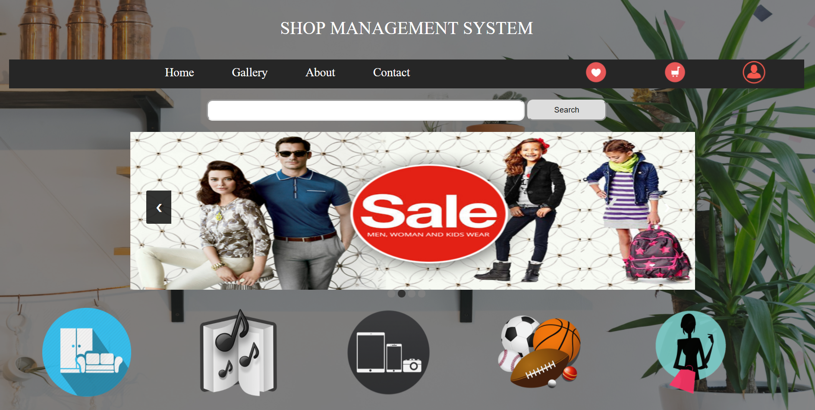
Home

Slide 7
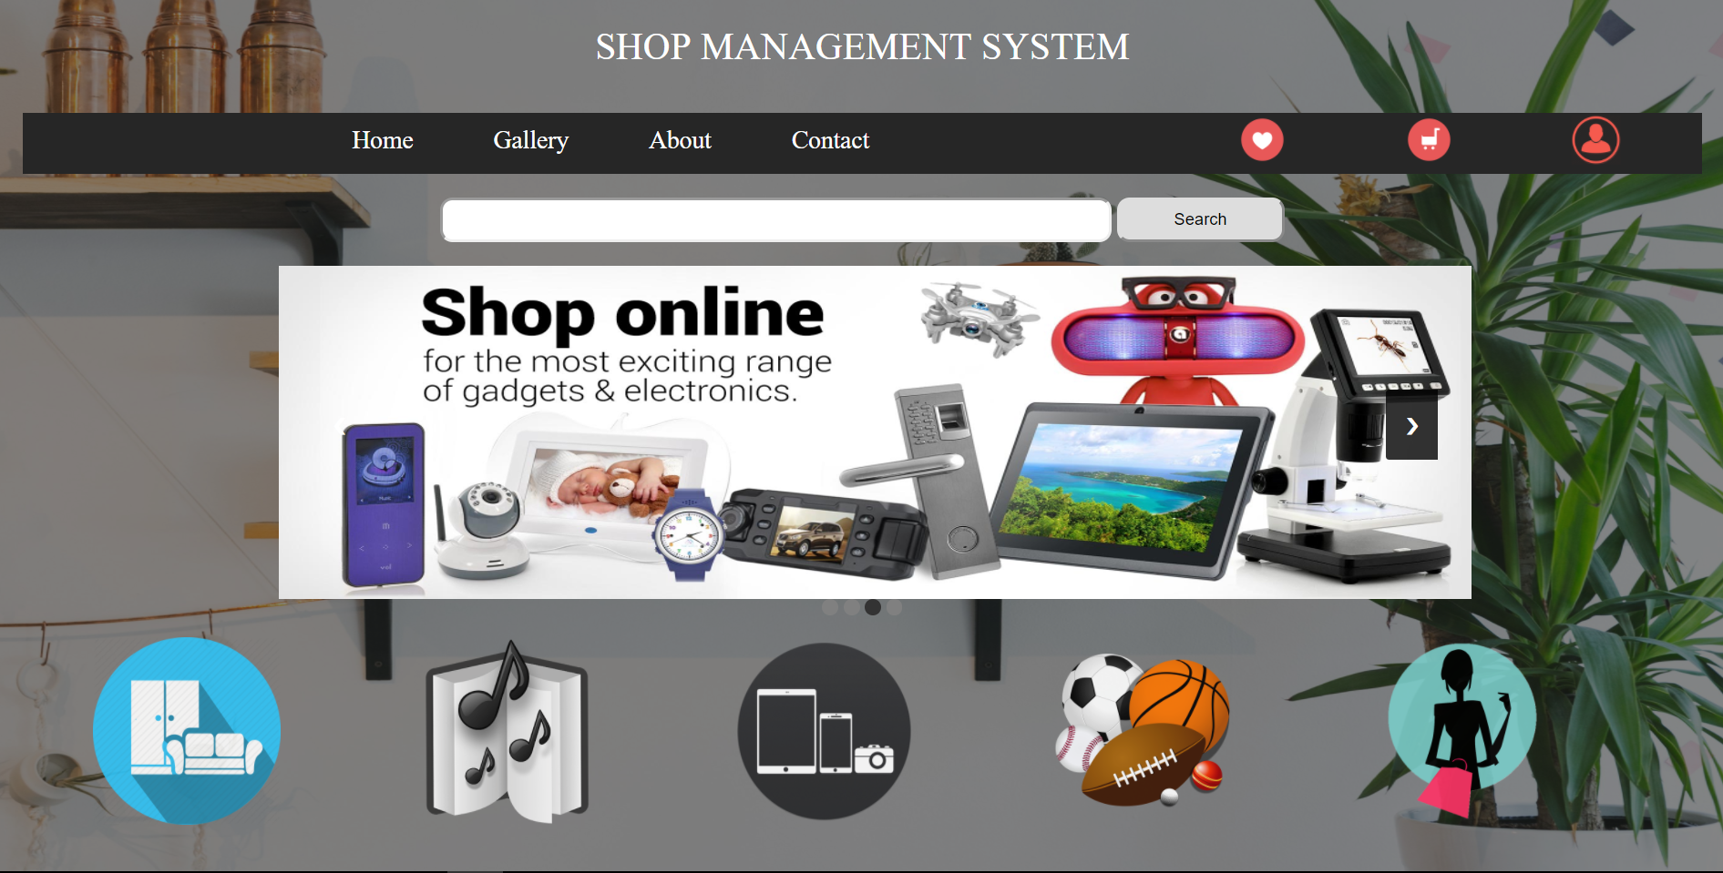
Interactive Image Slider

Slide 8
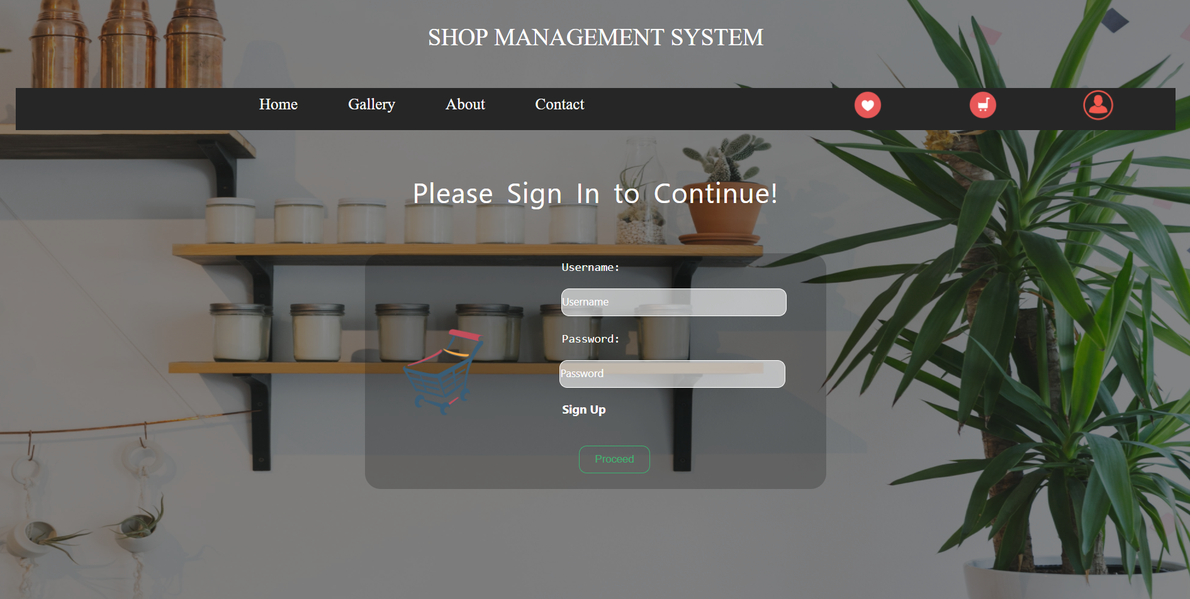
Login Page

Slide 9
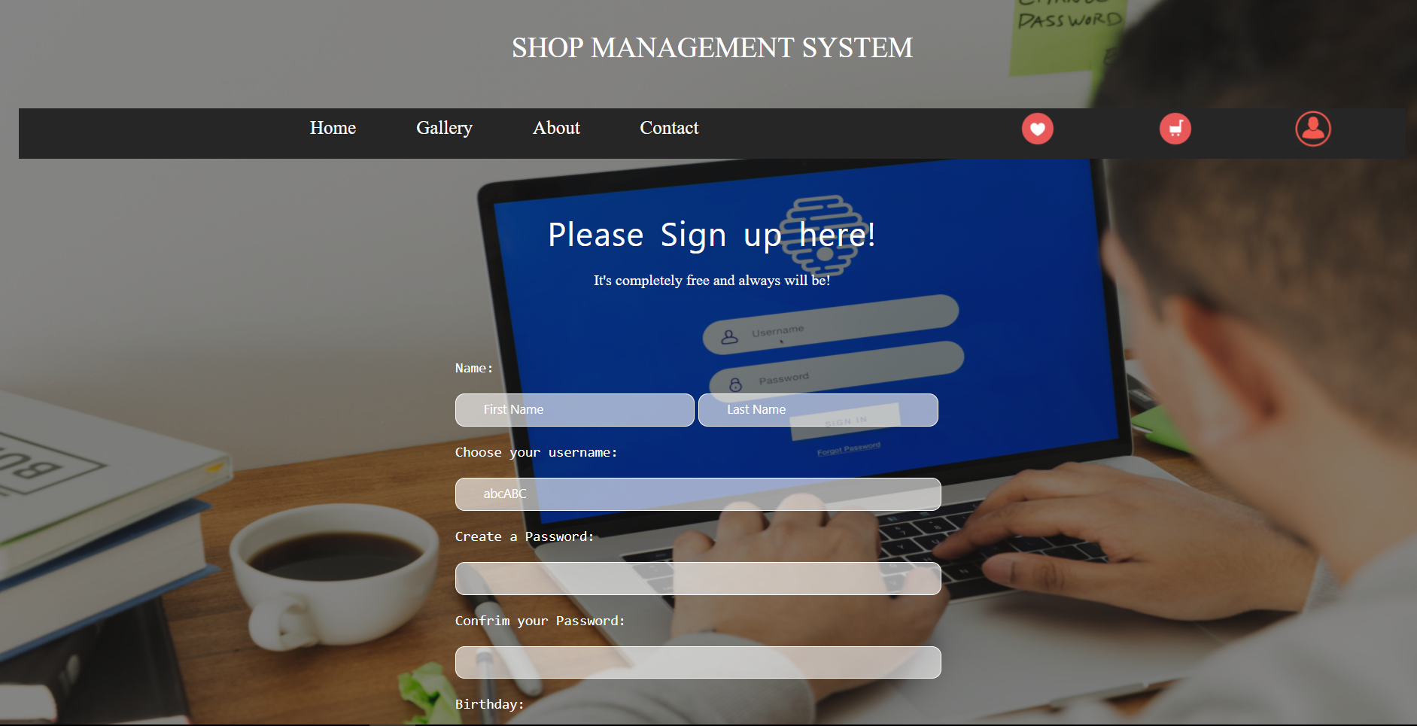
Sign Up Page

Slide 10
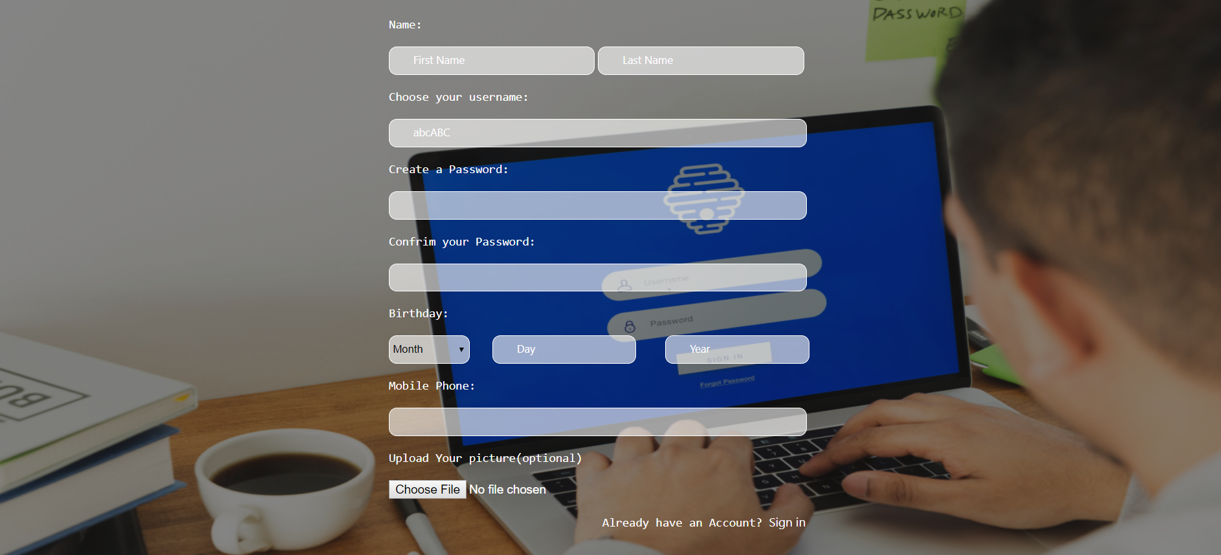
Sign Up Page

Slide 11
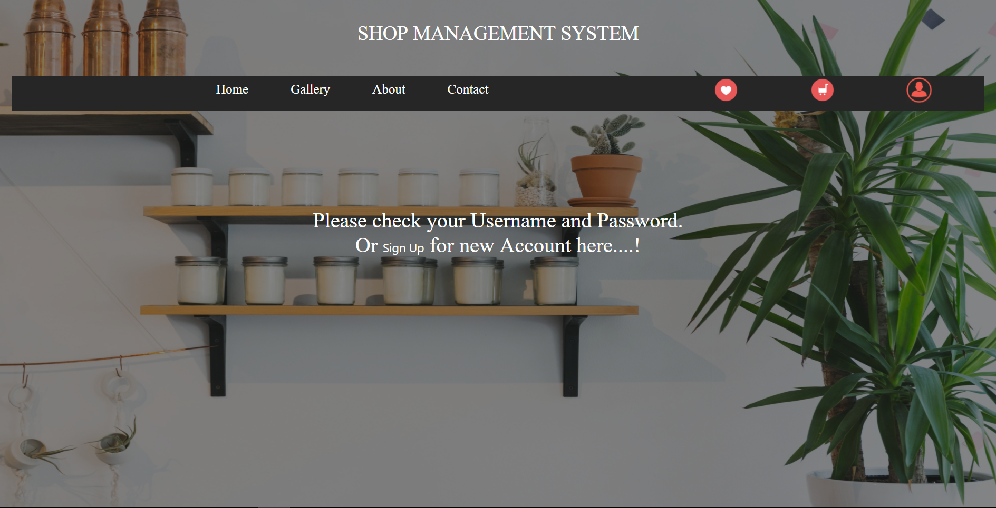
Response to actions(Login)

Slide 12
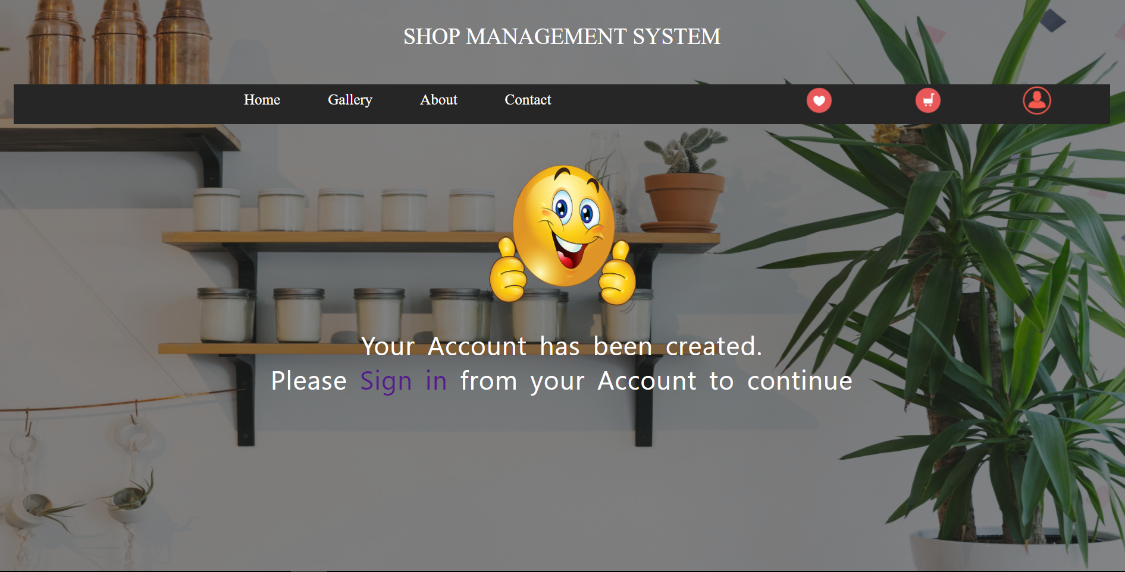
Response to Actions(Sign Up)

Slide 13
MAJOR COMPETITORS
Amazon.in
Started the specialty Online Store phenomena in America by Jeff Bezos on July 5, 1994. Revenues exceeded $6 billion in 2002. Average store gross revenue is $805,000. Now in 30 countries. Same store sales increased by 10% in 2002.
Flipkart.com
largest E-commerce website in India. Founded in 2007.
OLX
The largest Second hand product sale market In the country Founded in 2006.

Slide 14
THANK YOU!
CONTACT US AT:

